Slide 1
Heaven
Is Where Your Heart Is
Matthew 6.19-21

Slide 2

Heaven
Is Where
Your Heart Is
Definitions
The Heavens: The higher spatial and spiritual realms that include:
1. The aerial heavens: our atmosphere and outer space,
2. The ethereal heavens: the domain of evil spirits, and the abode of angels and God.

Slide 3
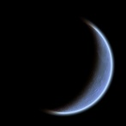

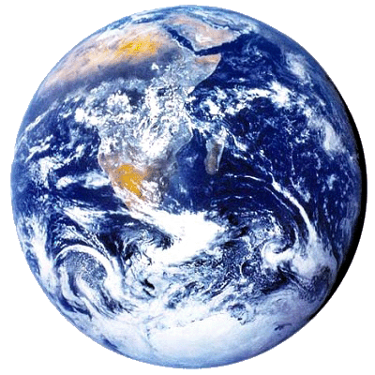
Heaven
Is Where
Your Heart Is
The Heavens 1
Atmosphere
Outer Space

Slide 4


Heaven
Is Where
Your Heart Is
The Heavens 2
Authority Of
The Air
Highest Heaven

Slide 5
Heaven
Is Where
Your Heart Is
Definitions
Paradise: The Garden of God, after which Eden was modeled. After Christ’s return, the restored, Eden-like, land of Israel will reflect the heavenly Paradise (Isaiah 51.3).

Slide 6
Heaven
Is Where
Your Heart Is
Definitions
Paradise: The restoration of the Edenic fellowship between man and God is a major theme in Scripture (Revelation 21.1-4; 22.1-4).

Slide 7
Heaven
Is Where
Your Heart Is
Definitions
The Highest Heaven: Also called the Third Heaven, is the present abode of God, the place of His throne, and the location of Paradise. This is where Jesus currently sits and where believers go when their bodies die. This is the Heaven we will talk about in this study.

Slide 8
Heaven
Is Where
Your Heart Is
Heaven did not always exist.

Slide 9
Heaven
Is Where
Your Heart Is
Heaven did not always exist.
God created Heaven, because He is inherently relational.

Slide 10
Heaven
Is Where
Your Heart Is
Heaven did not always exist.
God created Heaven, because He is inherently relational.
Heaven is the place where relationship can flourish between God and creatures made in His image.

Slide 11
Heaven
Is Where
Your Heart Is
What Is
Heaven Like?

Slide 12
Heaven
Is Where
Your Heart Is
We should not think of heaven…
as insubstantial. Heavenly bodies are more solid than material bodies. The resurrected Jesus walked through walls as we now walk through fog.

Slide 13
Heaven
Is Where
Your Heart Is
We should not think of heaven…
as inhospitable to bodily existence. In His glorified human body, Jesus is comfortable in both the earthly and heavenly realms. Heaven will feel familiar to us!

Slide 14
Heaven
Is Where
Your Heart Is
We should not think of heaven…
as filled with incomprehensible things. The apostle John was able to describe all that he saw in Heaven. Heaven will look familiar to us.

Slide 15
Heaven
Is Where
Your Heart Is
In fact…
earthly things are patterned after heavenly things, and heavenly things reflect God’s own heart. That is why we can see the attributes and character of God in His creation (Romans 1.20).

Slide 16
Heaven
Is Where
Your Heart Is
The implication of this is that…
everything we most love and long for in earthly existence, we will find more intensely real in Heaven.

Slide 17
Heaven
Is Where
Your Heart Is
Where is
Heaven?

Slide 18
Heaven
Is Where
Your Heart Is
Heaven is…
the context within which our universe exists. Heaven and our natural world are congruent. (See Job 1.1-7; Isaiah 57.15; John 14.23)
“Earth is not outside of heaven; it is heaven’s workshop, heaven’s womb.” – Peter Kreeft

Slide 19
Heaven
Is Where
Your Heart Is
Heaven is…
like the clear air that we pass through but do not see. When God temporarily attunes our senses to perceive Heaven, we have the sensation of the sky being peeled back.

Slide 20
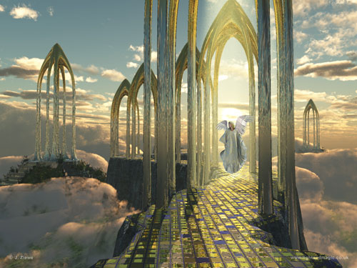

Slide 21
Heaven
Is Where
Your Heart Is
Heaven is not distant…
Is the Milky Way near or far?

Slide 22
Heaven
Is Where
Your Heart Is
Heaven is not distant…
Is the Milky Way near or far?
All the most important parts of our galaxy are near, beginning with the air we breath!

Slide 23
Heaven
Is Where
Your Heart Is
Heaven is so close that…
you’ve probably heard God’s voice. (See Acts 17.27.)

Slide 24
Heaven
Is Where
Your Heart Is
Heaven is so close that…
you’ve probably heard God’s voice. (See Acts 17.27.)
And you’ve stored treasure there! (See Matthew 6.19-21.)

Slide 25
Heaven
Is Where
Your Heart Is
Heaven is so close that…
if God attuned our eyes, we could see His angel armies arrayed around us (2 Kings 6.15-18), or Jesus at the right hand of God (Acts 7.55-56).

Slide 26
Heaven
Is Where
Your Heart Is
Heaven is so close that…
we can approach God’s throne right now (Hebrews 4.16), and if we were fully “in the spirit,” we could see God’s throne room as John did (Revelation 4.1-4).

Slide 27
Heaven
Is Where
Your Heart Is
Heaven is so close that…
we are surrounded by a vast crowd of saints who cheer for us as we run our spiritual race (Hebrews 12.1), and perhaps join God in rejoicing when a sinner repents (Luke 15.1-10).

Slide 28
Heaven
Is Where
Your Heart Is
In fact…
if we belong to Jesus, we are already in Heaven …!

Slide 29
Heaven
Is Where
Your Heart Is
In fact…
if we belong to Jesus, we are already in Heaven seated with Christ (Ephesians 2.4-6).
“Our citizenship is in heaven” now (Philippians 3.20).

Slide 30

Heaven
Is Where
Your Heart Is
Jesus is our passport!

Slide 31
Heaven
Is Where
Your Heart Is
WAIT! If we’re already in Heaven, why …
does my back still ache,
and I still get discouraged?

Slide 32
Heaven
Is Where
Your Heart Is
Our spirits are already tasting Heaven …
our sin-hindered will and emotions must catch up,
our bodies must be changed (Romans 8.23; 1Corinthians 15.51-52).

Slide 33
Heaven
Is Where
Your Heart Is
There is a real sense in which we are still on our way to Heaven…
We live in two realms simultaneously, Earth and Heaven.

Slide 34
Heaven
Is Where
Your Heart Is
But since Heaven is really where our heart is,
and since it is as near as our very breath…

Slide 35
Heaven
Is Where
Your Heart Is
Will we continue to live as though it is far, far away?

Slide 36
Heaven
Is Where Your Heart Is
Matthew 6.19-21

